Slide 1
CMOS VLSI Design Lecture 3: Simple Processor Example
Notes:
Hello and welcome. Today, our focus will be on a simple processor example.

Slide 2
Learning Objectives
At the end of this lecture, you should be able to
Describe and apply techniques for managing the design of complex systems.
Describe the implementation of a simple processor at abstraction levels including: Architecture, Microarchitecture, Logic Design, Circuit Design, Physical Design, Verification & Test.
Notes:
By the end of this lecture, you should be able to:
Describe and apply techniques for managing the design of complex systems.
Describe the implementation of a simple processor at abstraction levels including: Architecture, Microarchitecture, Logic Design, Circuit Design, Physical Design, Verification & Test.

Slide 3
Outline
Design Partitioning
Simplified Processor Example
Architecture
Microarchitecture
Logic Design
Circuit Design
Physical Design
Fabrication, Packaging, Testing

Slide 4
Coping with Complexity
How to design System-on-Chip?
Many millions (even billions!) of transistors
Tens to hundreds of engineers
Structured Design
Design Partitioning
Notes:
Modern System-On-Chip (SOC) designs use millions or billions of transistors. To manage this complexity of SoC designs, structured designs and design partitioning processes are used.
This approach enables large teams of engineers to work on different parts of the project for it to be successful.

Slide 5
Structured Design
Hierarchy: Divide and Conquer
Recursively system into modules
Regularity
Reuse modules wherever possible
E.g., standard cell library
Modularity: well-formed interfaces
Allows modules to be treated as black boxes
Locality
Physical and temporal
Notes:
Some structured designs are:
Hierarchy design approach that reduces the complexity of the system by dividing it into small simple modules.
Regularity design approach means that we try to reuse modules whenever it’s possible, like a standard cell library to build complex systems.
Modularity design approach means modules are treated as black boxes with well-formed interfaces which interact with other black boxes using specified protocols between interfaces to avoid unanticipated interactions.
And locality design approach minimizes the use of long-distance connections by keeping modules that interact frequently physically close to each other. This enables information to be kept close to where it is used, physically and temporally.

Slide 6
Design Partitioning
Architecture: User’s perspective, what does it do?
Instruction set, registers
ARM, MIPS, x86, Alpha, PIC, RISC-V, …
Microarchitecture
Single cycle, multicycle, pipelined, superscalar?
Logic: how are functional blocks constructed
Ripple carry, carry lookahead, carry select adders
Circuit: how are transistors used
Complementary CMOS, pass transistors, domino
Physical: chip layout
Datapaths, memories, random logic
Notes:
VLSI design is often partitioned into following levels of abstraction:
Architecture: It describes the functions of the system from the user’s perspective. For example, the instruction set, register set, and memory model.
Microarchitecture: It describes the processor architecture, its registers and functional units. For example, if the processor is single cycle, multicycle, pipelined or superscalar.
Logic: It describes how functional units are constructed. For instance, ripple carry, carry lookahead, carry select adders.
Circuit: It describes how transistors are used to implement the logic. For instance, complementary CMOS, pass transistors, and domino.
Physical: It describes the layout of the chip. For instance, datapaths, memories, and random logic.

Slide 7
Simplified Architecture
Example: simplified processor architecture
Drawn from DDCA ARM Ed. (Harris & Harris)
ARM is a 32-bit architecture with 16 registers
Consider 8-bit subset using 8-bit datapath for simplified processor
Only implement 8 registers (R0 - R7)
8-bit program counter in R7
You’ll build this simplified processor in the labs
Illustrate the key concepts in VLSI design
Notes:
The processor will have 8-bit registers (RO-R7) and use 8-bit datapath. The program counter in R7.

Slide 8
Instruction Set
Data Processing
ADD, SUB, AND, OR
Each accepts register/immediate 2nd sources
Memory
LDR, STR
Positive immediate offset
Branch
B
Notes:
Instruction set are the recognized instructions or command in machine code that are recognized by a processor.

Slide 9
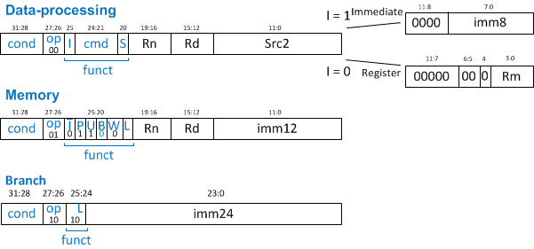
Instruction Encoding
32-bit instruction encoding
Requires four cycles to fetch on 8-bit datapath
Three instruction formats shown below
Distinguished by their op fields
Rd: destination register
Rn: first source register
Rm: second source register
Cond: conditional execution
Imm: immediate
cmd | instr
0100 | ADD
0010 | SUB
0000 | AND
1100 | OR
Notes:
Because of the 8-bit datapath, 32-bit instruction encoding will be fetched over four cycles.
The format of these instructions varies according to its use. For example:
In the case of data processing, the immediate values are the first 8 bits, but in the case of memory and branch, the values will be the first 12 and 24 bits, respectively.

Slide 10
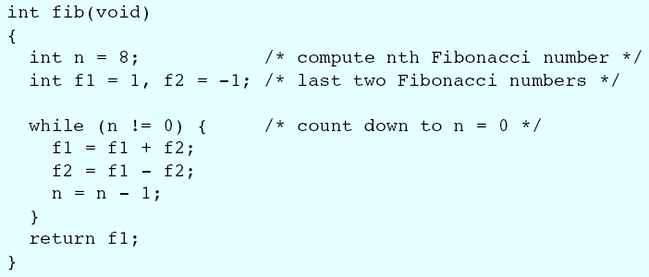
Fibonacci (C)
f₀ = 1; f₋₁ = -1
f_{n} = f_{n-1} + f_{n-2}
f = 1, 1, 2, 3, 5, 8, 13, …
Notes:
C level specification of the Fibonacci sequence (aka Fibonacci numbers).

Slide 11
Fibonacci (Assembly)
# fib.asm
# Register usage: R0 = 0, R3 = n, R4 = f1, R5 = f2
# Put result in address 255
fib add R3, R0, #8 # initialize n = 8
add R4, R0, #1 # initialize f1 = 1
add R5, R0, #-1 # initialize f2 = -1
loop subs R3, R0, end # n = 0?
beq done # then done
add R4, R4, R5 # f1 = f1 + f2
sub R5, R4, R5 # f2 = f1 – f2
add R3, R3, #-1 # n = n-1
b loop # repeat until done
done str R4, [R0, #255] # store result in adr 255
Notes:
Fibonacci program can also be written in Assembly as shown in this slide. Here the programmer must know the instruction set of the processor and the register use convention to write a good code.

Slide 12
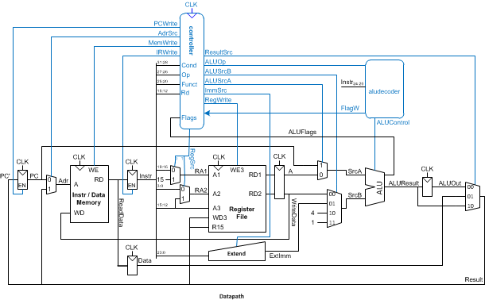
ARM Microarchitecture
Multicycle microarchitecture ( Harris DDCA ARM Ed.)
Notes:
By microarchitecture of a processor, we mean these details about the implementation of the CPU/processor like pipelining, instruction-level parallelism , caches, etc.
In this case you can observe the microarchitecture of an 8-bits processor.

Slide 13
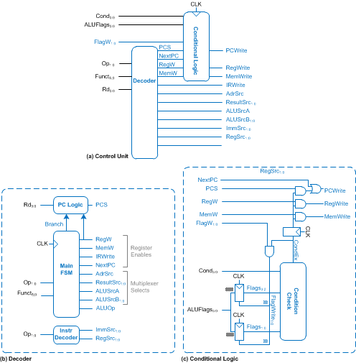
Multicycle Controller
Notes:
A multicycle controller will determinate the state of the processor, and in this case, it is made of a control unit, a decoder, and a condition logic.

Slide 14
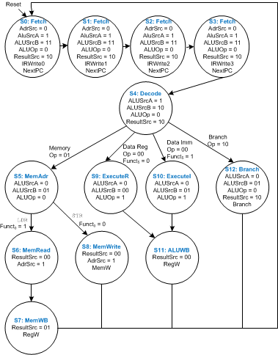
Multicycle FSM
Notes:
The finite state machine specifies the controller behavior.

Slide 15
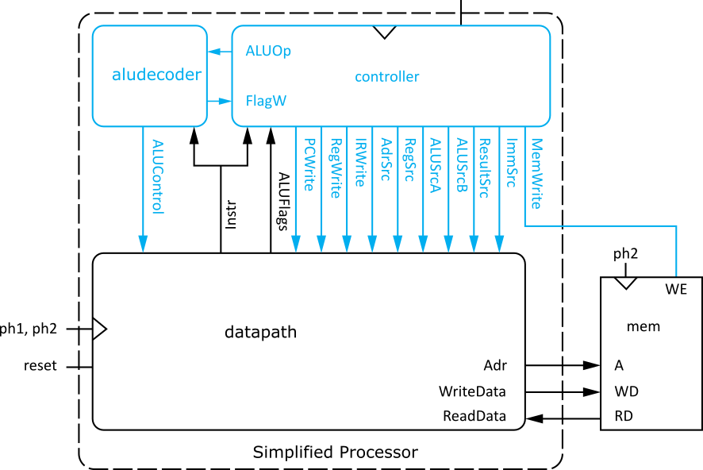
Logic Design
Start at top level
Hierarchically decompose simplified processor into units
Notes:
Logic design converts the microarchitecture specification into a high-level design using hardware descriptive languages; it starts at top level and hierarchically decompose the processor microarchitecture into units.

Slide 16
Hierarchical Design
Simplified Processor
Notes:
We can discompose the Simple 8-bits processor architecture into functional blocks and the design of these blocks.

Slide 17
HDLs
Hardware Description Languages
Widely used in logic design
Verilog and VHDL
Describe hardware using code
Document logic functions
Simulate logic before building
Synthesize code into gates and layout
Requires a library of standard cells
Notes:
HDLs or Hardware description languages such as Verilog and VHDL are widely used in logic design.
They are used for documentation of logic functions and for simulation. They are also be used to synthesize gates directly from the HDL.

Slide 18
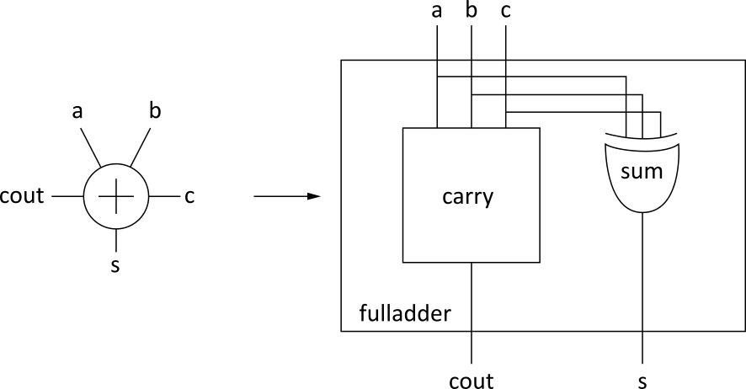
Verilog Example
module fulladder(input a, b, c,
output s, cout);
sum s1(a, b, c, s);
carry c1(a, b, c, cout);
endmodule
module carry(input a, b, c,
output cout)
assign cout = (a&b) | (a&c) | (b&c);
endmodule
Notes:
In Verilog, a module defines a cell and each module must end with the endmodule statement. The inputs and outputs are declared much as in a C program.
For instance. A full adder is expressed structurally with sum and carry subcircuits.
While the sum and carry subcircuits are expressed behaviorally.

Slide 19
Circuit Design
How should logic be implemented?
NANDs and NORs vs. ANDs and ORs?
Fan-in and fan-out?
How wide should transistors be?
These choices affect speed, area, power
Logic synthesis makes these choices for you
Good enough for many applications
Hand-crafted circuits are still better
Notes:
In designing circuits, the engineer must decide how the logic should be implemented. For example, the use of NANDS/NORs or ANDS/ORS gates. The engineer must consider fan-in or fan-out and how width of the transistors.
These choices will affect the speed, area, and power.
Logic synthesis makes these choices for you. It is good enough for many applications, but hand-crafted circuits are still better.

Slide 20
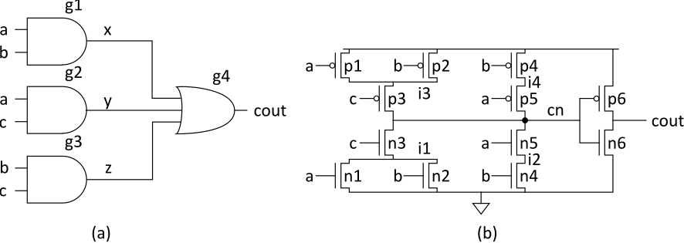
Example: Carry Logic
assign cout = (a&b) | (a&c) | (b&c);
Transistors? Gate Delays?
Notes:
In Verilog, circuits can be specified at transistor-level and logic-level.
For example, the figures below show two alternative circuit designs for
the carry circuit in a full adder.
The gate-level design on the left requires four stages of gate delays and 26 transistors (counting the transistors required to form the NAND and NOR plus their inverters to form AND and OR).
The transistor-level design on right requires only two stages of gate delays and 12 transistors. This illustrates the benefits of CMOS technology.

Slide 21
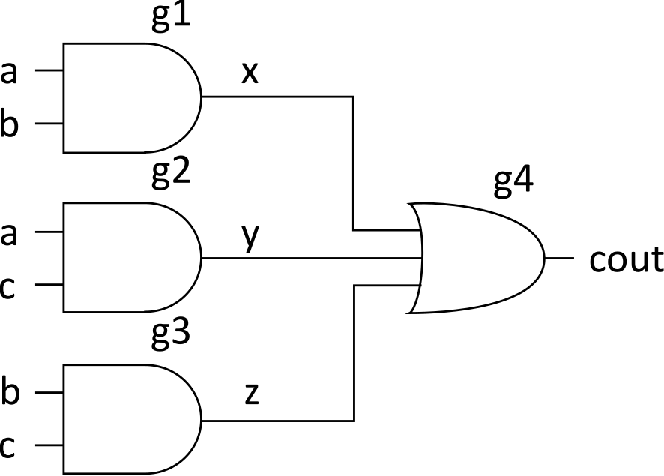
Gate-level Netlist
module carry(input a, b, c,
output cout)
wire x, y, z;
and g1(x, a, b);
and g2(y, a, c);
and g3(z, b, c);
or g4(cout, x, y, z);
endmodule
Notes:
The structural Verilog HDL is a common netlist format. The gate-level design shown above can be netlisted as above for simulation and verification.

Slide 22
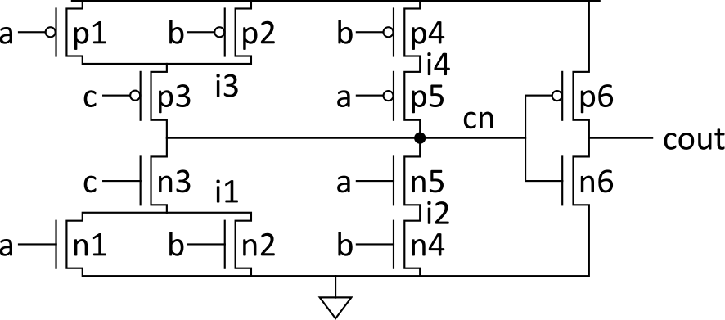
Transistor-Level Netlist
module carry(input a, b, c,
output cout)
wire i1, i2, i3, i4, cn;
tranif1 n1(i1, 0, a);
tranif1 n2(i1, 0, b);
tranif1 n3(cn, i1, c);
tranif1 n4(i2, 0, b);
tranif1 n5(cn, i2, a);
tranif0 p1(i3, 1, a);
tranif0 p2(i3, 1, b);
tranif0 p3(cn, i3, c);
tranif0 p4(i4, 1, b);
tranif0 p5(cn, i4, a);
tranif1 n6(cout, 0, cn);
tranif0 p6(cout, 1, cn);
endmodule
Notes:
Transistors are expressed as:
Transistor-type name (drain, source, gate);
tranif1 corresponds to nMOS transistors that turn ON when the gate is 1 while
tranif0 corresponds to pMOS transistors that turn ON when the gate is 0.

Slide 23
SPICE Netlist
.SUBCKT CARRY A B C COUT VDD GND
MN1 I1 A GND GND NMOS W=1U L=0.18U AD=0.3P AS=0.5P
MN2 I1 B GND GND NMOS W=1U L=0.18U AD=0.3P AS=0.5P
MN3 CN C I1 GND NMOS W=1U L=0.18U AD=0.5P AS=0.5P
MN4 I2 B GND GND NMOS W=1U L=0.18U AD=0.15P AS=0.5P
MN5 CN A I2 GND NMOS W=1U L=0.18U AD=0.5P AS=0.15P
MP1 I3 A VDD VDD PMOS W=2U L=0.18U AD=0.6P AS=1 P
MP2 I3 B VDD VDD PMOS W=2U L=0.18U AD=0.6P AS=1P
MP3 CN C I3 VDD PMOS W=2U L=0.18U AD=1P AS=1P
MP4 I4 B VDD VDD PMOS W=2U L=0.18U AD=0.3P AS=1P
MP5 CN A I4 VDD PMOS W=2U L=0.18U AD=1P AS=0.3P
MN6 COUT CN GND GND NMOS W=2U L=0.18U AD=1P AS=1P
MP6 COUT CN VDD VDD PMOS W=4U L=0.18U AD=2P AS=2P
CI1 I1 GND 2FF
CI3 I3 GND 3FF
CA A GND 4FF
CB B GND 4FF
CC C GND 2FF
CCN CN GND 4FF
CCOUT COUT GND 2FF
.ENDS
Notes:
The spice netlist is a text-based representation of our circuit that can be used for simulation.
Because the description generated so far still does not give other information such as the speed of the gate or its power consumption, we have to specify the transistors size and the stray capacitance.
Verilog is poorly suited to structural descriptions since it does not give this level of detail.
SPICE is more suited for this, as it is a structural language.
Above are the SPICE specification at the circuit level of the transistor-level carry subcircuit.

Slide 24
Physical Design
Floorplan
Standard cells
Place & route
Datapaths
Slice planning
Area estimation
Notes:
The physical design includes:
the floorplan,
standard cells,
datapaths,
and area estimation.

Slide 25
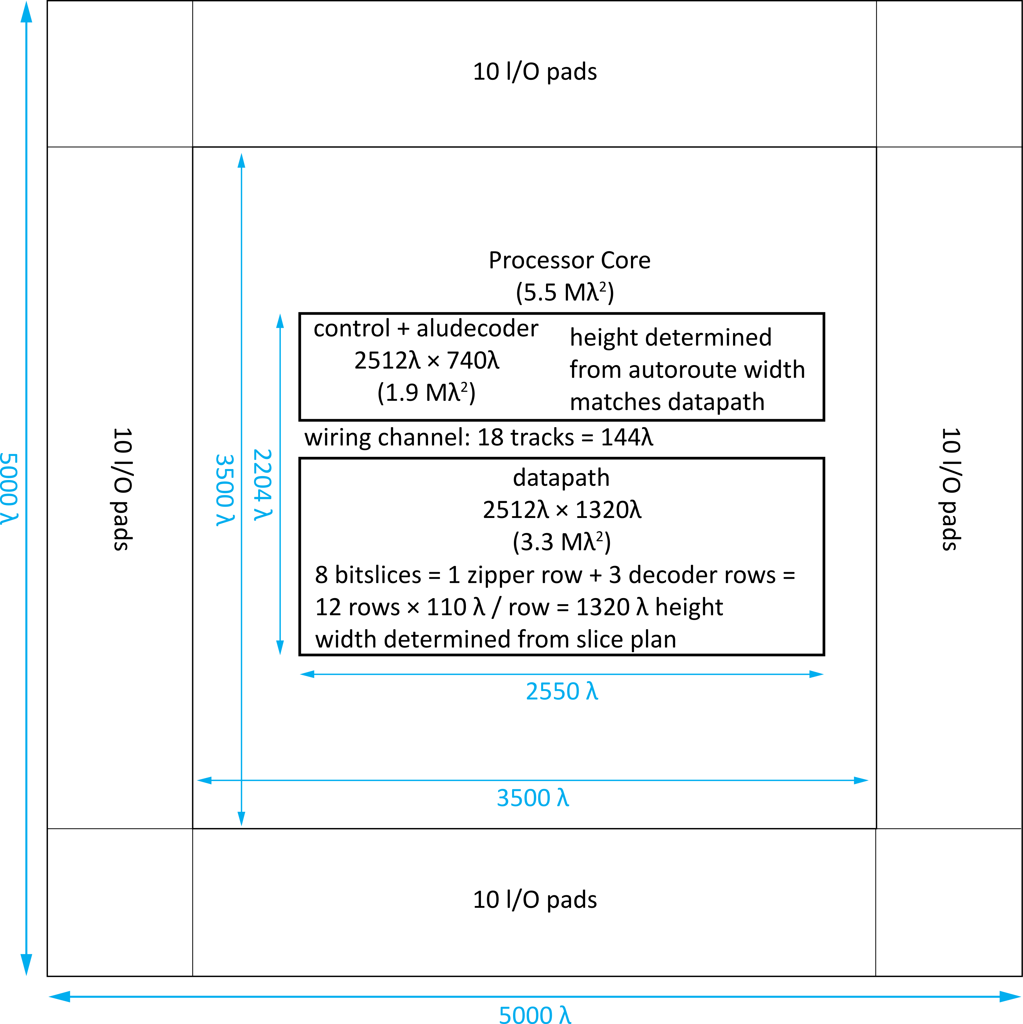
Simplified Processor Floorplan
Notes:
The floorplan is used to estimate the area of major units in the chip and to define their relative placements. It is essential:
To verify that the chip area can accommodate the proposed design and
To plan wiring to estimate wire lengths and congestion.
Figure above shows the floorplan (drawn to scale and annotated with dimensions) for the Simple 8-bit Processor chip, surrounded by the pad frame.

Slide 26
8-bit Processor Layout
Notes:
Layout of the Simple 8-bit Processor.

Slide 27
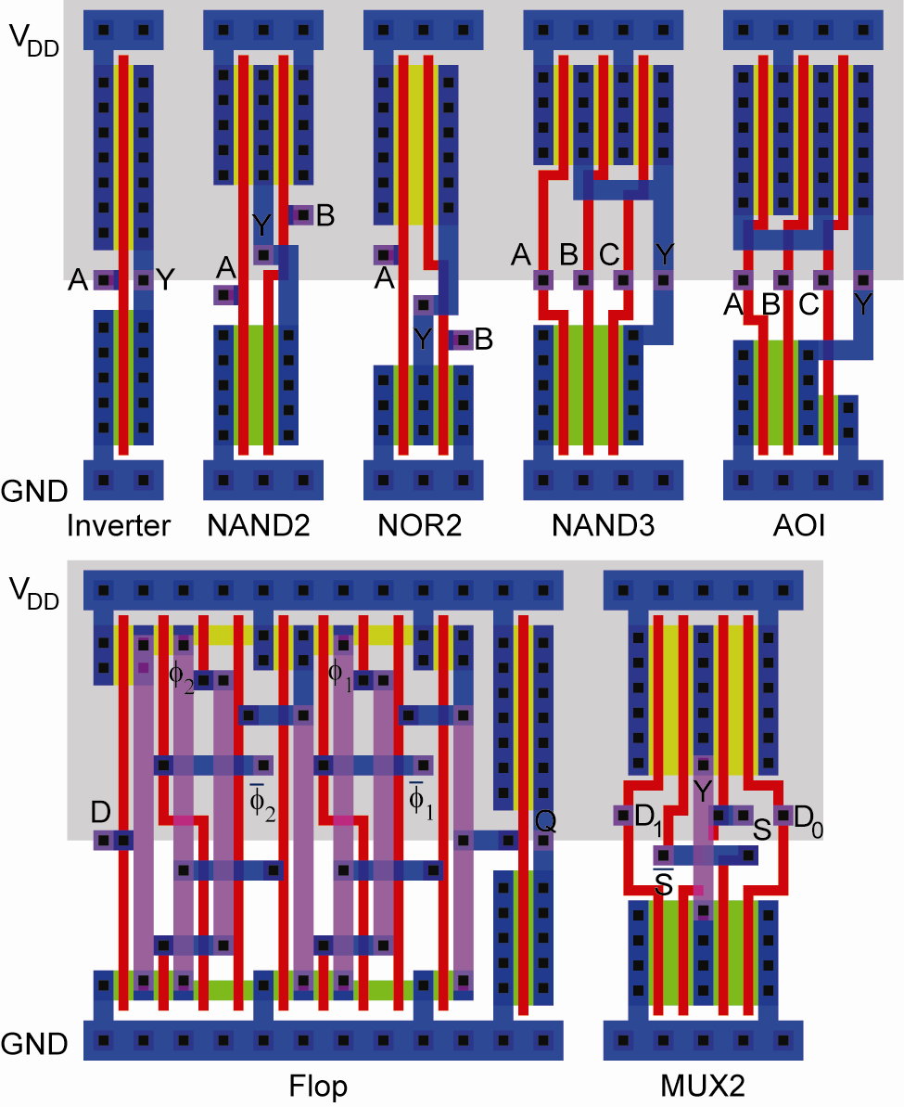
Standard Cells
Uniform cell height
Uniform well height
M1 V_{DD} and GND rails
M2 Access to I/Os
Well/substrate taps
Exploits regularity
Notes:
Standard cells in a library have:
-Use uniform height for cells and wells
Metal 1 for Vdd and GND rails.
Metal 2 for I/Os
-Well/substrate tabs
-Exploit regularity

Slide 28
Synthesized Controller
Synthesize HDL into gate-level netlist
Place & Route using standard cell library
Notes:
Layout of synthesized controller, obtained from synthesizing the HDL into a gate-level netlist of standard cells, which is then placed and routed using a standard tool.

Slide 29
Pitch Matching
Synthesized controller area is mostly wires
Design is smaller if wires run through/over cells
Smaller = faster, lower power as well!
Design snap-together cells for datapaths and arrays
Plan wires into cells
Connect by abutment
Exploits locality
Takes lots of effort
Notes:
The synthesized controller area is mostly wires. The design could be smaller if wires run through/over cells; this will also result in faster performance and lower power consumption.
You must design snap-together cells for datapaths and arrays. Plan wires into cells and ensure connection by abutment to exploit locality. The process takes a lot of effort.

Slide 30
Simple 8-bit Processor Datapath
8-bit datapath built from wordslices
Zipper at top drives control signals to datapath
Register File Decoder
Zipper
Bitslice 7
Bitslice 1
Flop Wordslice
Adder Wordslice
Notes:
Layout of Simple 8-bit Processor datapath; it contains 8-bit datapath built from the wordslices and a zipper at the top to drive control signals.

Slide 31
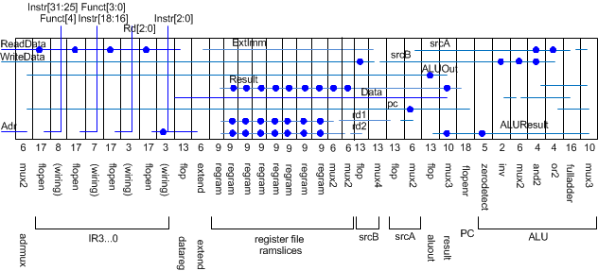
Slice Plans
Slice plan for bitslice
Cell ordering, dimensions, wiring tracks
Arrange cells for wiring locality
Notes:
For bitslice, plan for cell ordering, dimension, and wiring track with the aim of arranging cells for wiring locality.

Slide 32
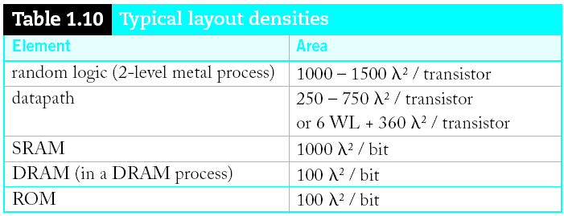
Area Estimation
Need area estimates to make floorplan
Compare to another block you already designed
Or estimate from transistor counts
Budget room for large wiring tracks
Your mileage may vary; derate by 2x for class.
Notes:
For area estimation, it is always good to compare your block with another that is already designed or estimate from the transistor counts.

Slide 33
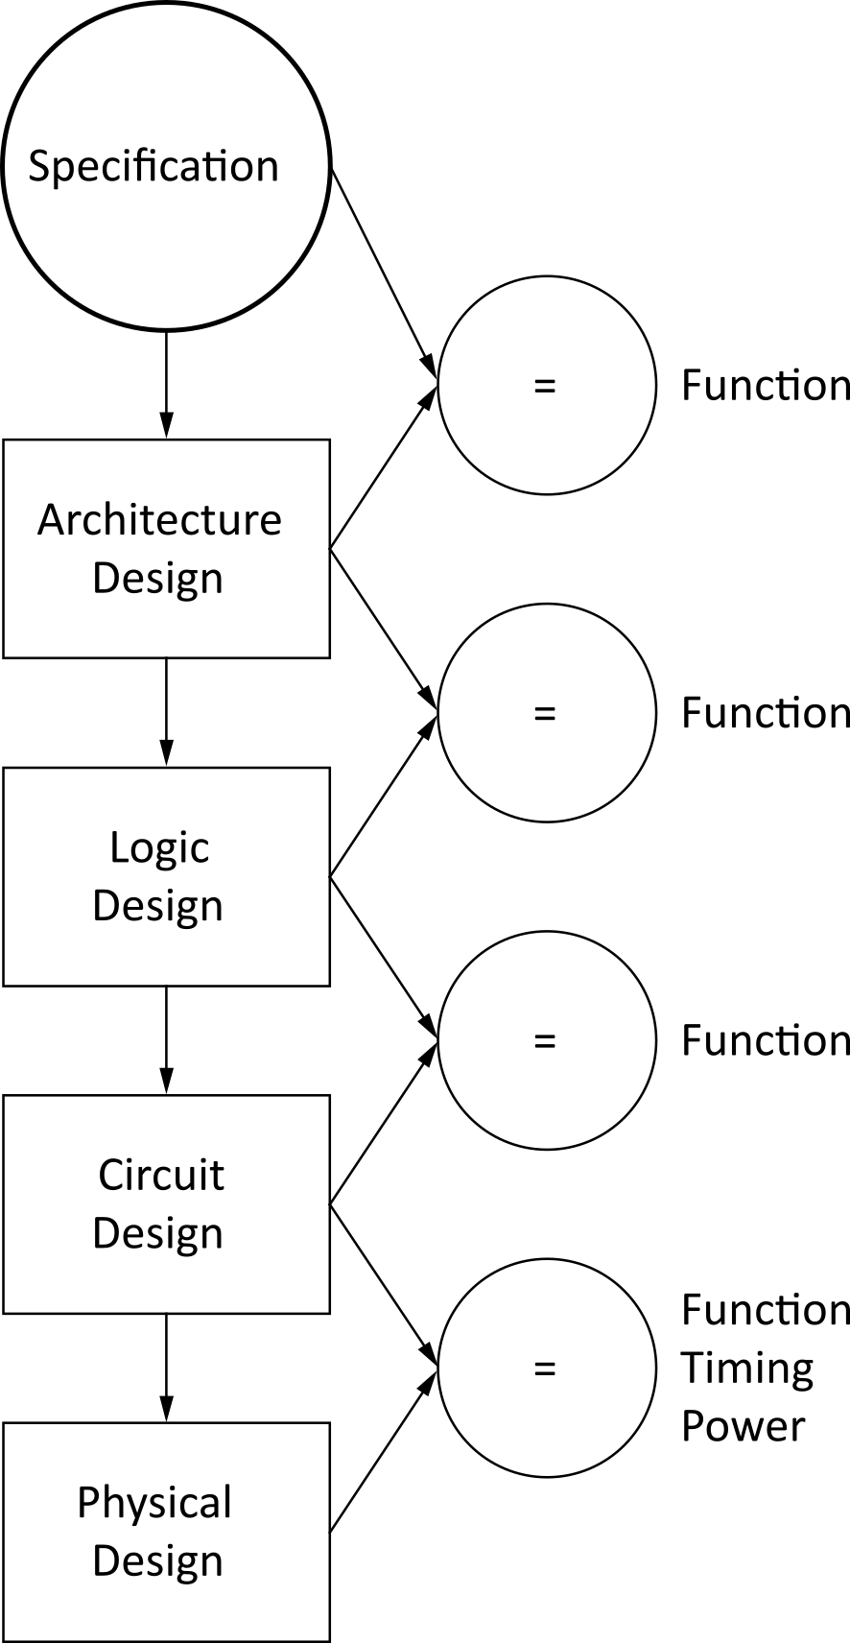
Design Verification
Fabrication is slow & expensive
MOSIS 0.6 µm: $1000, 3 months
65 nm: $3M, 1 month
Debugging chips is very hard
Limited visibility into operation
Prove design is right before building!
Logic simulation
Circuit simulation/formal verification
Layout vs. schematic comparison
Design & electrical rule checks
Verification is >50% of effort on most chips!
Notes:
It is important that we do design verification because fabrication is slow & expensive.
Debugging chips is very hard because of the limited visibility into the operation.
We must prove that the design is right before building. This can be done by Logic simulation, Circuit simulation/formal verification, Layout vs. schematic comparison, Design & electrical rule checks.

Slide 34
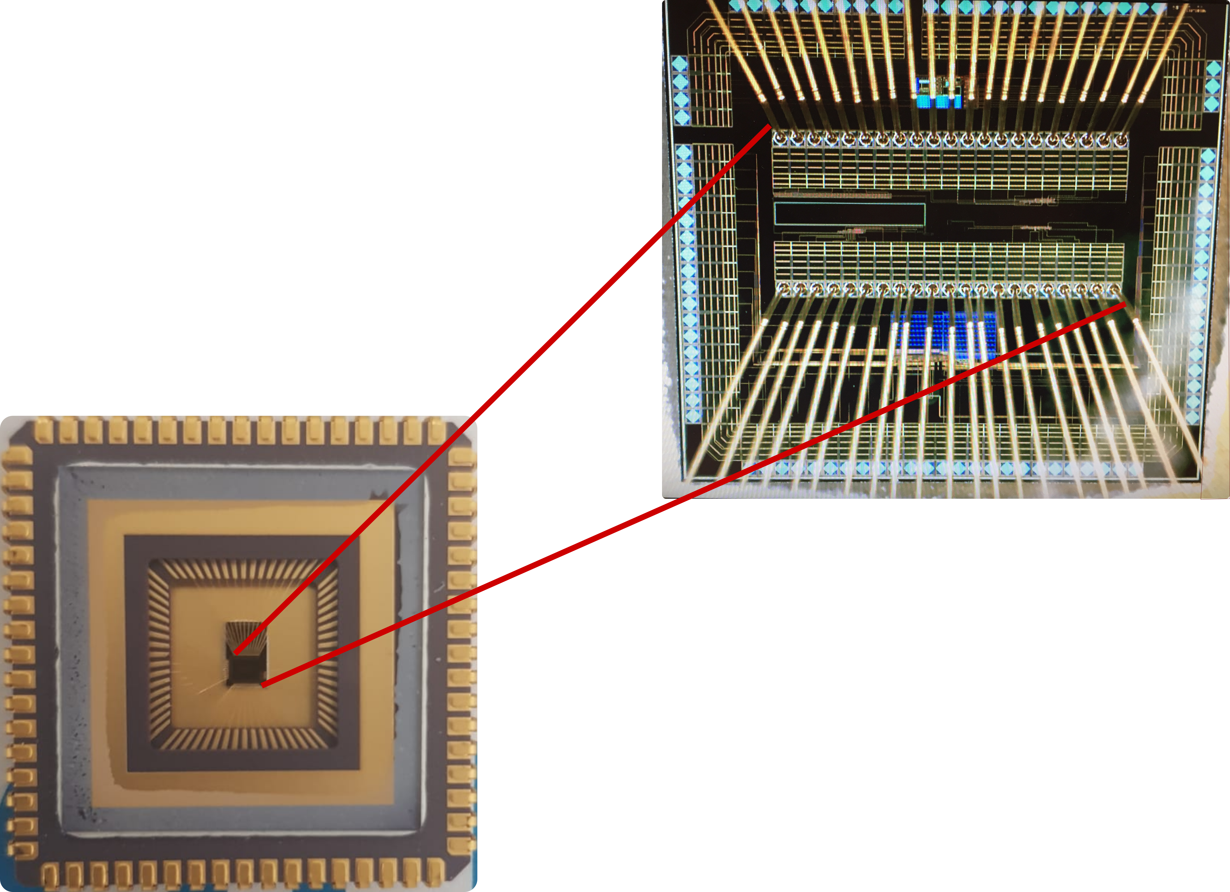
Fabrication & Packaging
Tapeout final layout
Fabrication
6, 8, 12” wafers
Optimized for throughput,
not latency (10 weeks!)
Cut into individual dice
Packaging
Bond gold wires from die I/O pads to package
Notes:
In the fabrication & packaging step, the layout of the design is sent out for fabrication. Usually take weeks, maybe10 weeks, to be fabricated in wafer that will be cut into individual dice. Finally, the die is bonded to the I/O pads of the package. Gold wires are used for bonding.

Slide 35
Testing
Test that chip operates
Design errors
Manufacturing errors
A single dust particle or wafer defect kills a die
Yields from 90% to <10%
Depends on die size, maturity of process
Test each part before shipping to customer
Notes:
Finally, the chip is tested after fabrication for any design or manufacturing error.
A single dust particle or wafer defect kills a die, which may decrease the yields from 90% to <10%. Therefore, each part is tested before shipping to the customer.

Slide 36
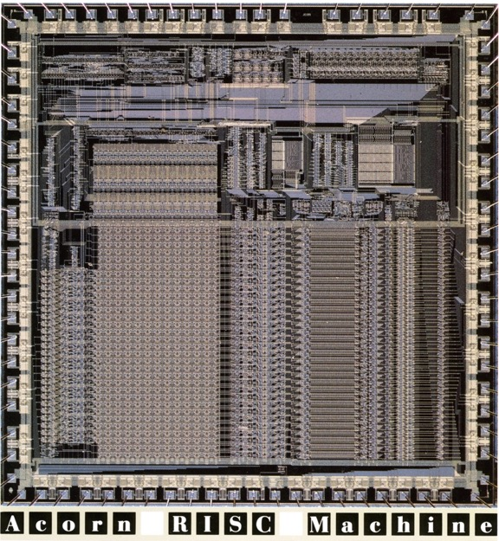
ARM1 Processor
1st generation ARM chip (1985)
24,800 transistors
3-stage pipeline
8 MHz
3 μm process
49 mm²
82-pin PLCC package
Average power = 0.1 W
2-phase nonoverlapping
clocks
Built for Acorn Computer
© 1985 ARM Ltd.
Notes:
The figure shows the layout of 1st generation ARM processor. It has 24,800 transistors , 3-stage pipeline, 8 MHz frequency , 3 mm process and an average power of 0.1 W.

